Slide 1
Development of IoTcloudServe@TEIN Smart-Energy@Chula Service Gateway : Case Study of Secured On-Demand Building Energy Management System Data Platform Using NETPIE
Ririnda Thirasupa
Meechai Homchan
Siravit Kwankajornkeat
Chaodit Aswakul
Department of Electrical Engineering, Faculty of Engineering, Chulalongkorn University, Bangkok, Thailand
Notes:
Good morning everyone! My name is Siravit Kwankajornkeat. Today, I will present my undergrad research, Development of ………

Slide 2
1
Introduction
Notes:
For this part, IoTcloudserve@TEIN, Smart-Energy@Chula, and secured data sharing will be mentioned

Slide 3





IoTcloudServe@TEIN
2
Smart-Energy@Chula
(CU-BEMS)
Korea
Japan Malaysia Laos Thai
Integrate research and educational network communities
Research &
Education
Ref & Pictures Credit : https://www.facebook.com/iotcloudserve/ & https://pixabay.com/ & https://th.wikipedia.org/wiki/
Notes:
The objective of our research is to join Smart-Energy@Chula, which is based on CU-BEMS, to IoTcloudServe@TEIN.
And next, I will mention more about CUBEMS.

Slide 4
CU-BEMS
3
Chula’s Building Energy Management System
IEEE 1888 protocol server engine
More than 250 energy-related sensors and smart meters
Real-time readings, 800 data points per second, are sent to
CU-BEMS storage
Goal : Provide IDaaS to raise people
awareness of energy usage
Ref : https://apan.net/meetings/apan46/files/11/11-02-04-01.pdf & http://www.bems.ee.eng.chula.ac.th:9061/bems.web/
Notes:
CU-BEMS is a Building Energy Management System in Chulalongkorn University with the technical support of IEEE 1888 (I triple E eighteen eighty-eight) protocol server engine from the University of Tokyo, is readily available with more than two hundred and fifty energy-related sensors and smart meters that send the real-time energy and room ambient readings which generated eight hundred data points per second to CU-BEMS storage. The main goal is to raise people awareness of energy usage by providing Interactive Display as a Service (IDaaS).
เผื่อต้องพูด : Ex. a smart meter records energy usage of air conditioning systems inside a room and motion sensors in that area check the people movement. If no motion is detected in that room, then the CU-BEMS will alarm the waste energy usage of the air-conditioning system for energy saving.
Sensors : illuminance, humidity, temp, energy, motion detector

Slide 5
Secured Data Sharing using NETPIE
4
Provide a secured means of interacting with CU-BEMS OpenData
repository by implementing an interworking service gateway
& using NETPIE security mechanisms
Notes:
For secured data sharing, a secured means of interacting with CU-BEMS OpenData repository by implementing an interworking service gateway & using NETPIE security mechanisms must be provided

Slide 6
5
Design of CU-BEMS OpenData repository in Smart-Energy@Chula System
Notes:
This part will mention about design ……

Slide 7
Challenges & Facts
6
CU-BEMS’s shared resources : function or micro-service
: sensor and control data
Sensor and control data must be secured
To share data securely : share data manually Not real-time
: share data periodically (not on-demand)
to avoid CU-BEMS storage server overload
Notes:
In CU-BEMS cloud, คลิก 1 ครั้ง there are two resources types to be shared such as function or micro-service and sensor and control data. คลิก 1 ครั้ง The fact is Sensor and control data must be secured.
คลิก 1 ครั้ง So, there are two methods to share data securely, first is to share data manually, and second is to share data periodically. These methods are used คลิก 1 ครั้ง to avoid CU-BEMS storage server overload.
เผื่อต้องพูด : Why the data must be secured? → to protect system from malicious

Slide 8
Challenges & Facts (cont.)
7
CU-BEMS is a building automation system
A building automation system needs on-demand real-time data
sharing for decision-making algorithm :
a secured means, using NETPIE security mechanisms, enables
secured on-demand sharing of CU-BEMS OpenData repository via
the interworking service gateway
Notes:
คลิก 1 ครั้ง
CU-BEMS is a building automation system and คลิก 1 ครั้ง
A building automation system needs on-demand real-time data sharing for decision-making algorithm, so, คลิก 1 ครั้ง There must be a secured means, using NETPIE security mechanisms, enables secured on-demand sharing of CU-BEMS OpenData repository via the interworking service gateway

Slide 9
8
Interworking Service Gateway
and Proof-of-Concept Secured
On-Demand Data Fetching
Functionality Test
Notes:
In IEEE 1888 (I triple E eighteen eighty-eight) protocol, there are three sub-protocols such as
Fetch, Trap, and Write.
This research focus only Fetch which used to request for data.
เผื่อต้องพูด : Fetch is to request for data
Trap is to request for warning
Write is to write data

Slide 10
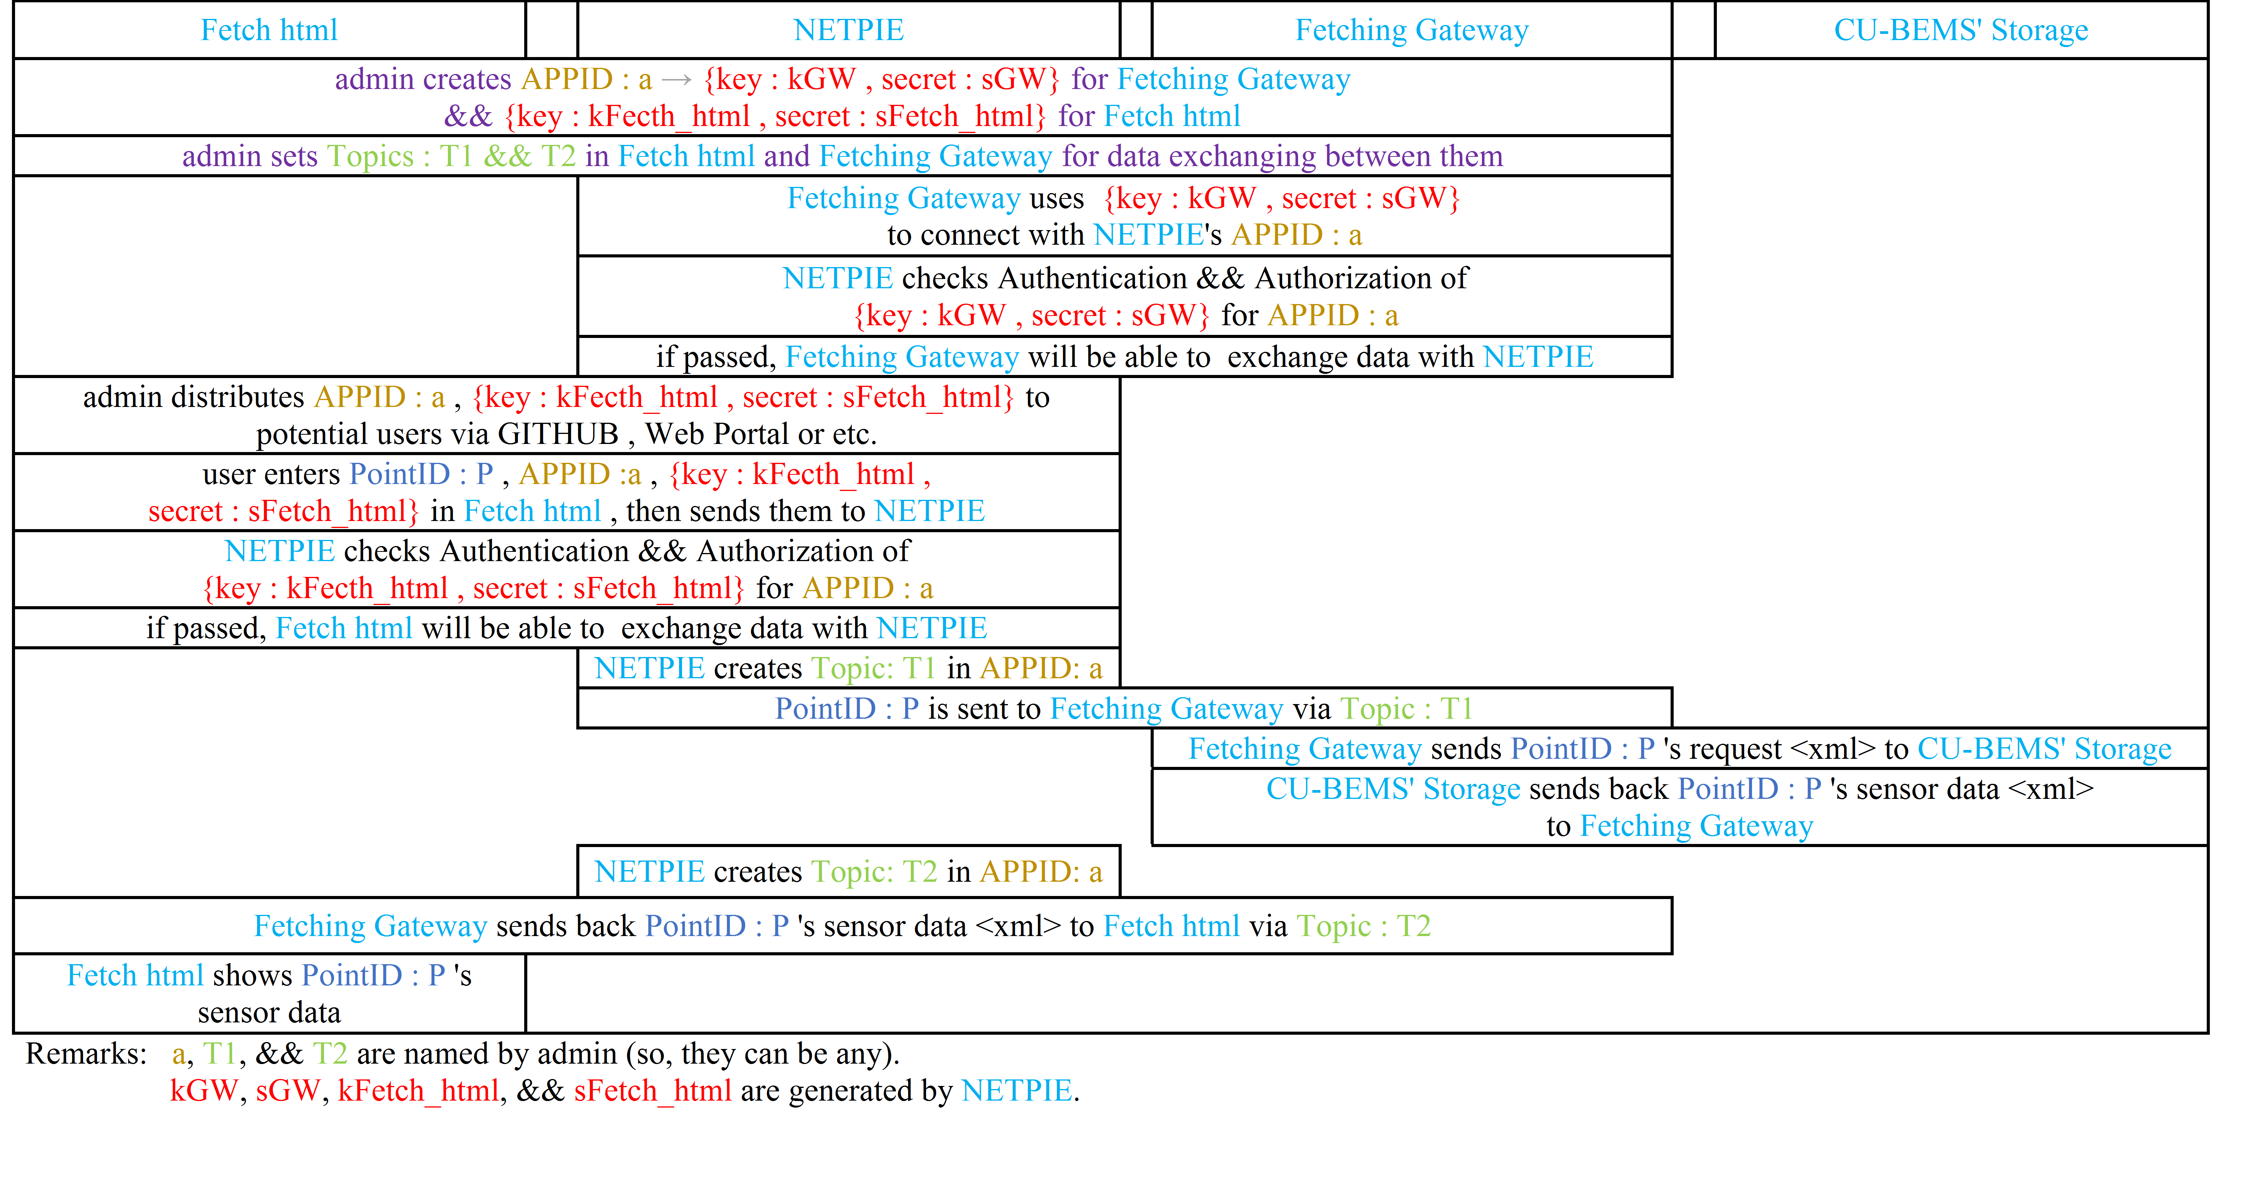
Procedures
9
Notes:
This procedure detail shows how the system works.
The briefly procedure will be mentioned next.

Slide 11
Initial Set-Up before Fetching
10
Admin creates APPID, key-secret pairs in the APPID for the service
Gateway and Fetch html (html webpage).
Admin sets Topics in the Gateway and Fetch html for data
exchanging between them.
Admin runs the Gateway on a server → the Gateway connects
to NETPIE.
Notes:
Before data exchanging,
คลิก 1 ครั้ง First, admin creates ….
คลิก 1 ครั้ง Then admin sets …..
คลิก 1 ครั้ง And run the Gateway on server

Slide 12
Fetching Procedures
11
(1) sends Token && Input Data to NETPIE via NETPIE REST API
NETPIE
(2) If the key Authentication && Authorization passes, NETPIE will sends Input Data to Topic : T1 of NETPIE MQTT
Topic : T1
Topic : T2
(3) forwards Input Data to node.js Gateway
(7) forwards sensors’ data to Fetch.html
via NETPIE REST API
Fetch.html used to request
CU-BEMS’ data
by input sensors’ URLs, NETPIE’s key && secret && APPIDs
(4) requests for sensors’ data
(6) forwards sensors’data
to
Topic : T2 via NETPIE MQTT
node.js Gateway
CU-BEMS Storage
main work
(5) sends back sensors’ data to node.js Gateway
Notes:
คลิก 7 ครั้ง
There are seven steps for secured data exchanging, but for fetching without security focused, คลิก 1 ครั้ง, there are only two steps such as fourth and fifth steps.
On this research, คลิก 1 ครั้ง, secured on-demand data is needed, so, there must be an interworking service gateway that uses to communicate between NETPIE which uses MQTT protocol and CU-BEMS which uses IEEE 1888 (I triple E eighteen eighty eight) protocol.
In this scenario, Topics T one & T two must be created for subscribing and publishing data of the gateway.
เผื่อต้องพูด : HTTP REST API supports both XML & JSON data format, but SOAP supports only XML

Slide 13
NETPIE Security Mechanisms
12
NETPIE APPID
There are key-secret pairs created in each NETPIE APPID
key-secret pair 1
key-secret pair 2
.
key-secret pair n
Ref : https://netpie.io/
Notes:
For NETPIE security mechanisms detail, there are key-secret pairs created in each NETPIE APPID.

Slide 14
NETPIE Security Mechanisms (cont.)
13
IoT 1 IoT 3
IoT 2 IoT n
Only the IoTs which uses key-secret pairs created in the same APPID
can exchange data to each other
KEY 1
KEY 3
NETPIE APPID
KEY 2
KEY n
Ref : https://netpie.io/
Notes:
Only the IoTs which uses key-secret pairs created in the same APPID can exchange data to each other.

Slide 15
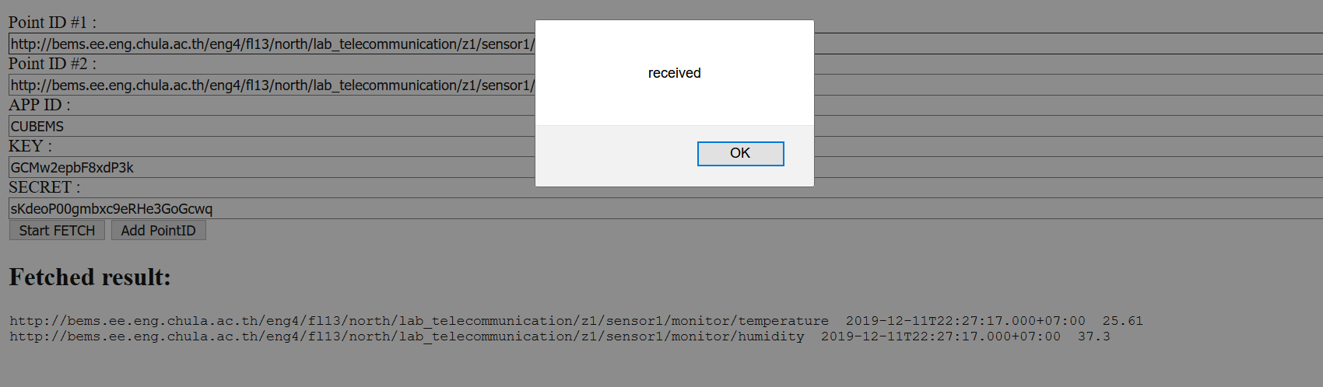
Fetching Result
14
Notes:
The requested sensors’ data at the latest stored timestamp have been successfully fetched upon with no errors. The number in red rectangle are the sensors’ values.

Slide 16
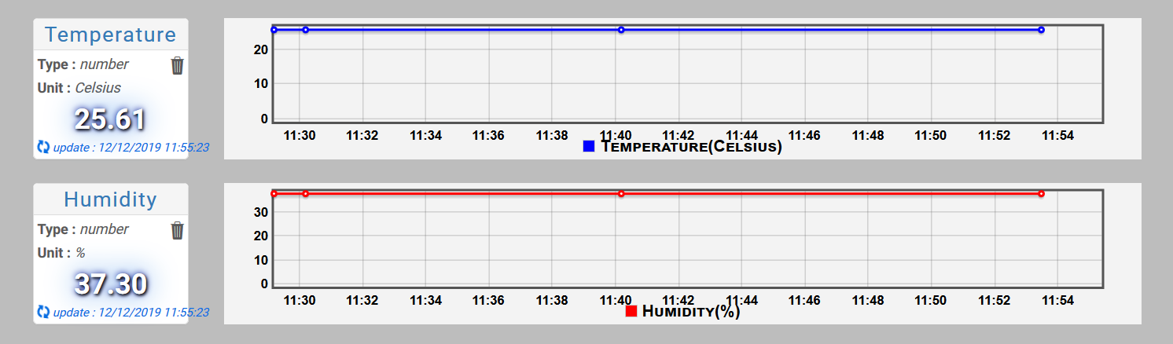
Plotting the Result to NETPIE FEED
14
Notes:
The requested sensors’ data at the latest stored timestamp have been successfully fetched upon with no errors. The number in red rectangle are the sensors’ values.

Slide 17
15
The Gateway Performance Testing

Slide 18
Experimental Setup
16
Test the interworking service gateway performance
- Time delay : time duration since the gateway sends request
data to CU-BEMS until it receives CU-BEMS reply data
- CPU usage : percentage of CPU usage of server which runs
the gateway while fetching data
- Server specifications : Windows 10 Pro 64 bits, 16 GB RAM, and
Core i7-8850U, 1.8 GHz, 8 Cores CPU
- 30 minutes continuously test via 20 Mbps internet package
Notes:
The gateway test is focused on คลิก 1 ครั้ง time delay and CPU usage คลิก 1 ครั้ง on Windows ten Pro sixty four bits, sixteen GigaByte RAM, and
Core i Seven, one point eight GHz, eight Cores CPU server คลิก 1 ครั้ง within thirty minutes continuously test via twenty Mbps internet package.

Slide 19
Experimental Setup (cont.)
17
→ 3 main cases : fetching sensors’ data at 5, 25, and 125 URLs
per gateway request
→ 11 subcases : fetching the data at rate 1, 5, 10, 15, 20, 25, 30,
35, 40, 45, and 50 requests per second (req/s)
for each main cases
Each case was repeated for 25 times using 95% confidence interval
Notes:
There are thirty three test cases, คลิก 1 ครั้ง three main cases and คลิก 1 ครั้ง eleven subcases for each main cases, คลิก 1 ครั้ง each case was repeated for twenty five times using ninety five percent confidence interval.

Slide 20
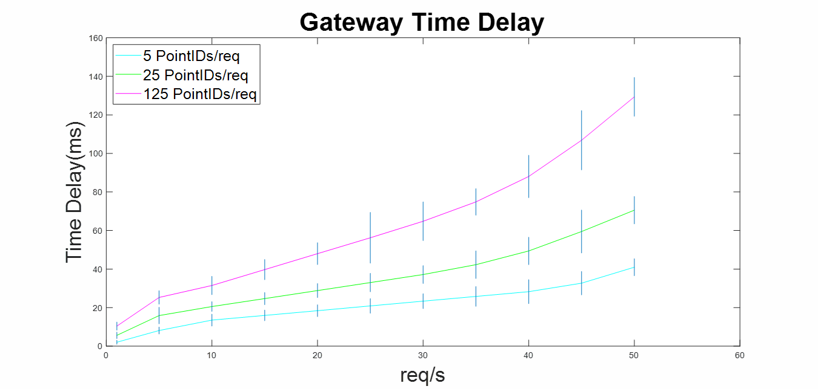
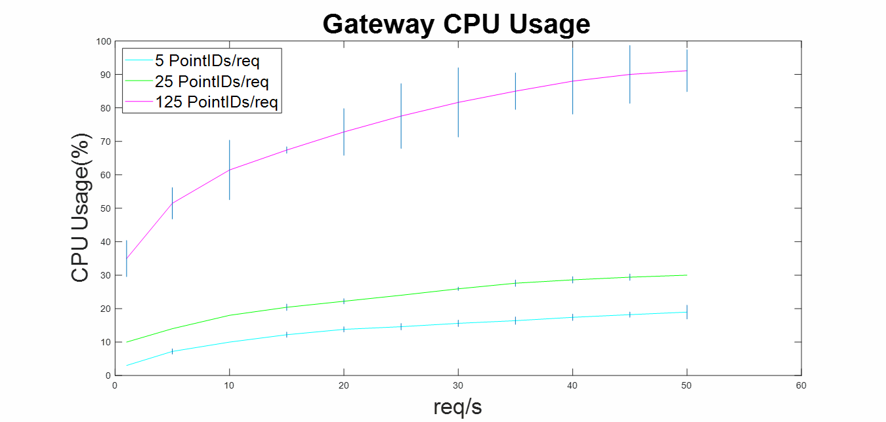
Results & Discussion
18
Time delay depends on
CPU usage which depends
on a number of requested
sensors per second.
A vertical blue line represents
mean range of each case which
depends on network state between
the server and CU-BEMS at a time.
Notes:
The results show that time delay depends on CPU usage which depends on a number of requested
sensors per second. A vertical blue line represents mean range of each case which depends on network state between the server and CU-BEMS at a time.
Because CU-BEMS can generate eight hundred data points per second, but the gateway is able to support up to six thousand two hundred and fifty pointIDs per second, so, the gateway performance is enough for CU-BEMS

Slide 21
19
Conclusion

Slide 22
20
Secured on-demand data can be requested by using the
interworking service Gateway to fetch CU-BEMS’s sensor values
from the html webpage with NETPIE Security Mechanisms
The development of the Gateway in this research enhances the
building energy management to be compliant with different
communication protocols, which could be useful for researchers
and manufacturers in the future.
Notes:
This research shows that secured on-demand data …… & The development of ……..

Slide 23
21
Thank You
Notes:
Thanks for your attention, Thank you very much

Slide 24
22
Q & A
Notes:
If you have any questions, feel free to ask
IoTcloudServe@TEIN is one of TEIN projects which compose of three sub-projects such as
Smart agriculture, Smart mobility, and Smart energy (CU-BEMS).
For MQTT protocol communication, Topics must be created to be data exchange points.
Publishers IoTs publish data to the Topics
Subscriber IoTs who need that data subscribe the Topics to receive the data
An IoT can be both publisher and subscriber at the same time
Pros : easy to extend the network because it is real-time (while HTTP REST API is not) and clients can connect together without knowing each other
IEEE 1888 Protocol composes of :
Data Storage is used to recode data generated from other components
Application is used to show sensors’ data or command actuators
Gateway is used to exchange data between field-bus and TCP/IP networks
Field-bus network is a network of sensors and actuators
Registry is used to components together

Slide 25
A closer look
of
the existing systems

Slide 26
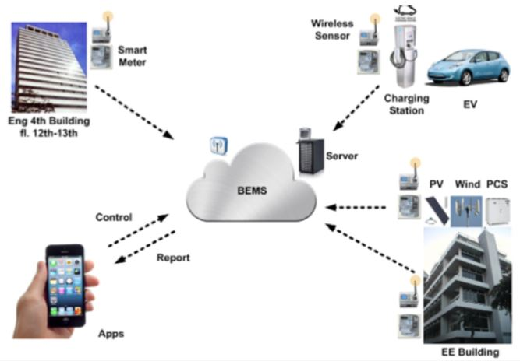
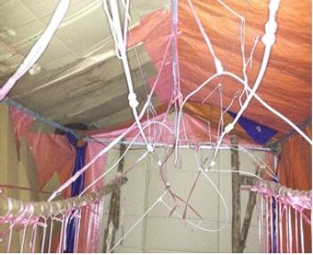
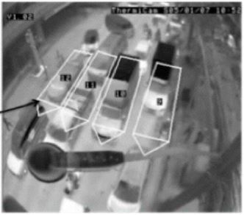
IoTcloudServe@TEIN
Smart Energy Smart Agriculture
(My Work)
Smart Mobility
Ref & Pictures Credit : https://apan.net/meetings/apan46/files/11/11-02-04-01.pdf
Notes:
IoTcloudServe@TEIN is one of TEIN projects which compose of three sub-projects such as
Smart agriculture, Smart mobility, and Smart energy (CU-BEMS).
My work is focused on Smart energy.
Start – End : 20 June 2018 – 19 April 2020

Slide 27
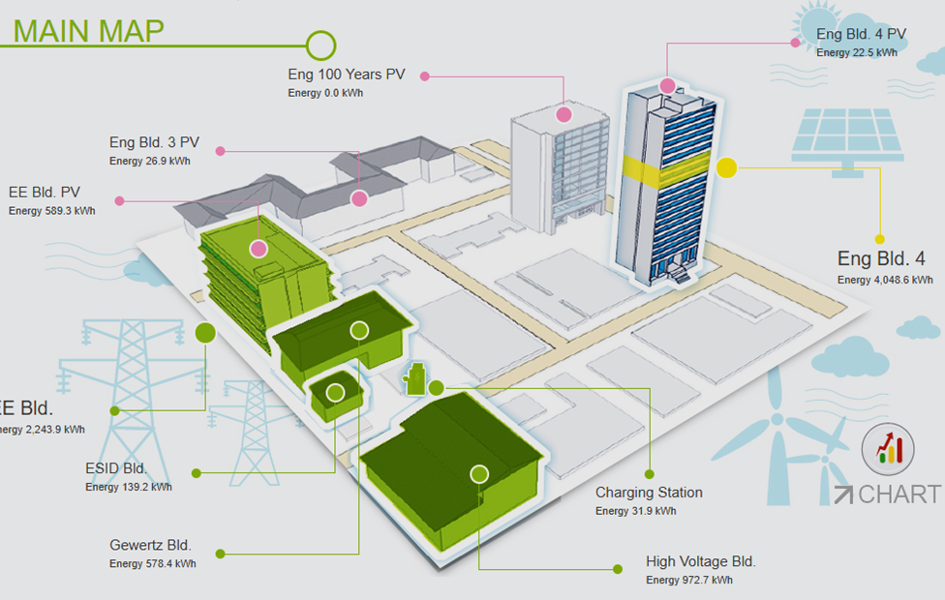
Smart-Energy@Chula (CU-BEMS)
IEEE 1888 protocol server with sensors and actuators in EECU
More than 250 energy-related sensors and smart meters send the
real-time energy and room ambient readings to CU-BEMS storage
Ref : https://apan.net/meetings/apan46/files/11/11-02-04-01.pdf & http://www.bems.ee.eng.chula.ac.th:9061/bems.web/
Notes:
CU-BEMS is a Building Energy Management System with the technical support of IEEE 1888 protocol server engine from the University of Tokyo, is readily available with more than 250 energy-related sensors and smart meters that send the real-time energy and room ambient readings to CU-BEMS storage.

Slide 28
IEEE 1888 & MQTT Protocols
IEEE 1888 : Simple Object Access Protocol (SOAP) → support
only data in XML format
MQTT : exchange data via created Topics
Data 1 Data 1
Data n Data n
MQTT Broker
.
.
Topic 1
Topic n
Ref : https://ieeexplore.ieee.org/stamp/stamp.jsp?arnumber=7098298 & https://netpie.io/

Slide 29
A closer look
of
IEEE 1888

Slide 30
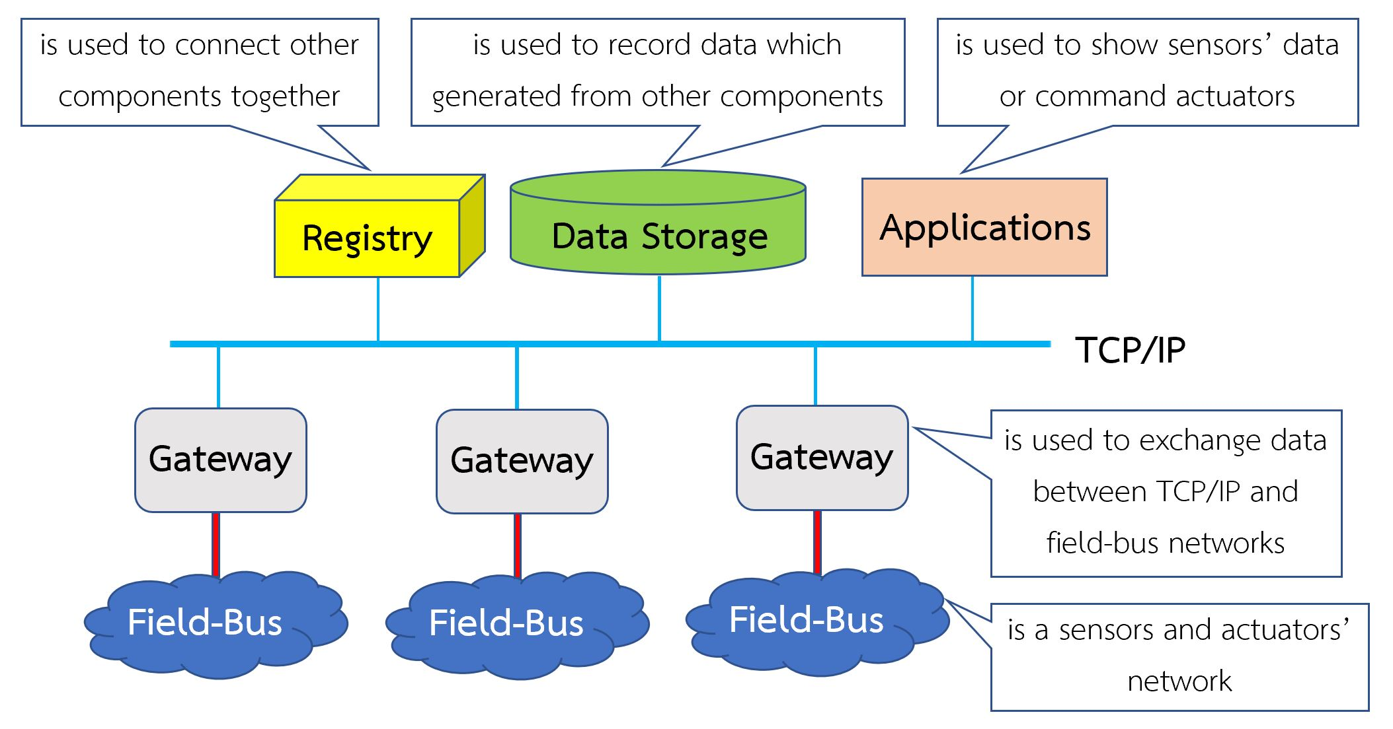
IEEE 1888 Protocol
Ref : https://ieeexplore.ieee.org/stamp/stamp.jsp?arnumber=7098298

Slide 31
IEEE 1888 Communication Protocols
• FETCH is used to request data from one component to
another.
• TRAP is used to request warning according to set conditions
from one component to another.
• WRITE is used to write data from one component to another.
IEEE 1888 Message Protocol
Simple object access protocol, SOAP supports only XML data
Ref : https://ieeexplore.ieee.org/stamp/stamp.jsp?arnumber=7098298
Notes:
IEEE 1888 Protocol has 3 communication protocols such as FETCH ใช้ร้องขอข้อมูล, TRAP ใช้ ร้องขอการแจ้งเตือน, WRITE ใช้ในการเขียนข้อมูล ,
and Simple object access protocol, supports only XML, is data format of IEEE 1888 protocol
In this research uses only FETCH for communication protocol.

Slide 32
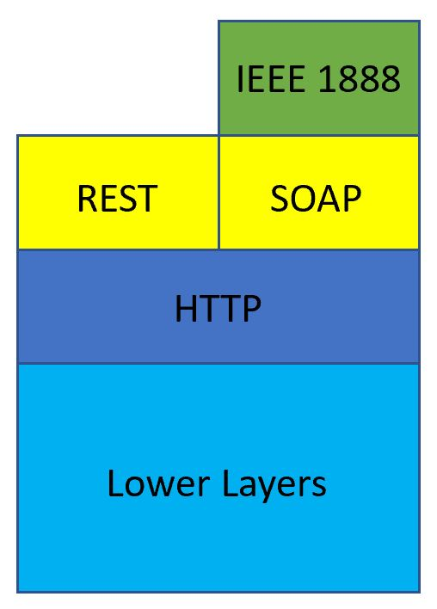
Architecture of each Hardware
Ref : https://ieeexplore.ieee.org/stamp/stamp.jsp?arnumber=7098298
Notes:
IEEE 1888 Database ทำงานบน SOAP protocol ซึ่ง SOAP protocol สามารถทำงานอยู่บน Protocol ใดก็ได้ แต่ต้องใช้ข้อความในรูปแบบ XML เท่านั้น
ส่วน REST API (ซึ่งรองรับข้อความได้ทั้ง JSON, XML, Plain Text) จะทำงานได้เฉพาะบน HTTP เท่านั้น
เผื่อต้องพูด : ข้อดีของ SOAP Protocol : สนับสนุนเรื่อง security อยู่แล้ว ทั้ง authentication, authorization และ data encryption
ข้อเสีย : XML มี overhead สูงกว่าข้อความในรูปแบบอื่นๆ

Slide 33
A closer look
of
MQTT & Microgear

Slide 34
MQTT Protocol
A publisher sends data to Topics.
A subscriber subscribes the Topics to receive data from publishers.
A client can be both publisher and subscriber at a time.
Client
(Publisher)
MQTT Broker
Topic #1
Client
(Publisher & Subscriber)
Client
(Subscriber)
Topic #n
http://203.159.154.241/innogoth/wpcontent/uploads/2017/09/NETPIE-WS_v23.pdf

Slide 35
NETPIE Microgear
• Be installed on devices (except HTML 5 Microgear) that want to
connect to NETPIE by using MQTT protocol.
• Uses to authenticate & authorize devices that want to join
NETPIE by using AppID, Key in KEY, and Token.
Ref : https://netpie.io/

Slide 36
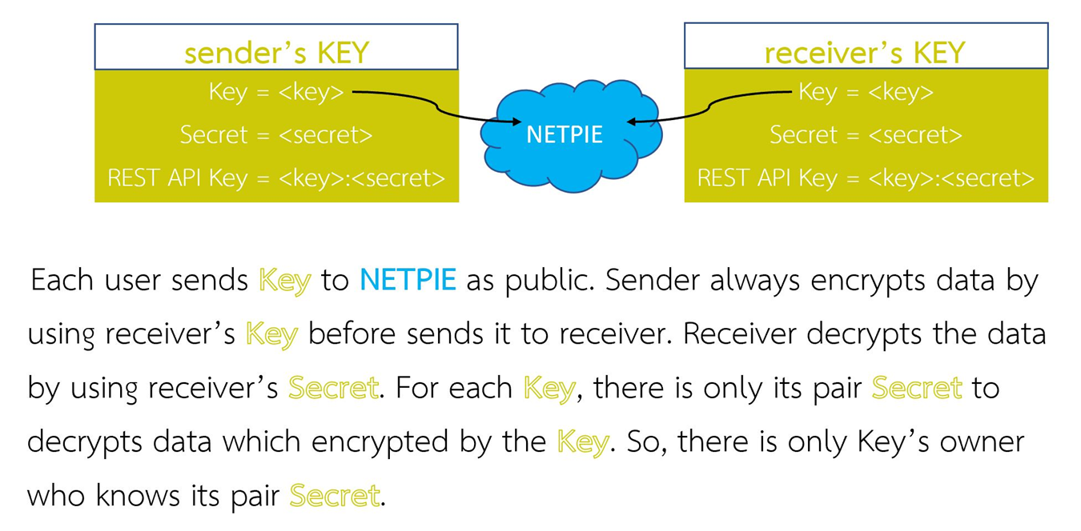
NETPIE Microgear (cont.)
Ref : https://netpie.io/

Slide 37
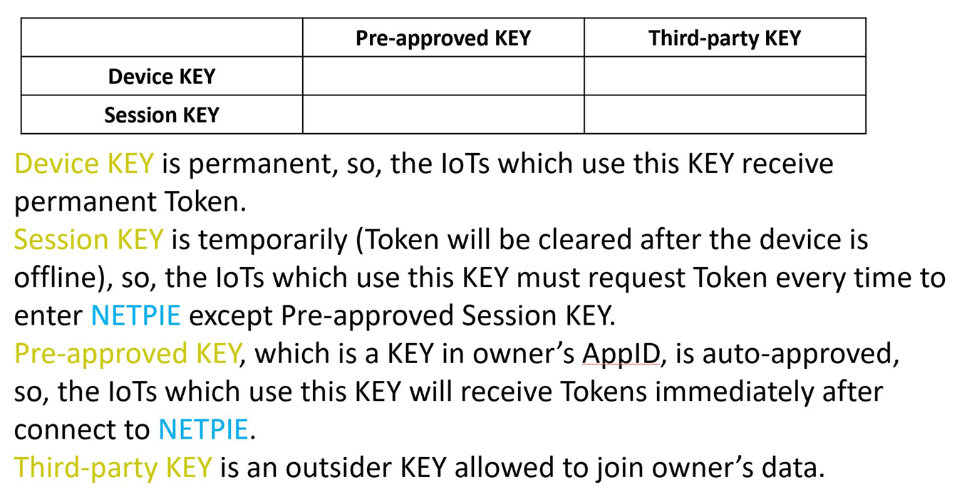
NETPIE Microgear (cont.)
Ref : https://netpie.io/

